Slide 1

KAVACH

Slide 2

Voice-Activated Safety Device
Empowering Personal Safety with Technology

Slide 3
Why Personal Safety Matters
The importance of personal safety in modern society
The rising need for innovative safety solutions
Statistics on the increase in personal safety concerns

Slide 4

Solution: A Voice-Activated Safety Device
Voice-activated safety features
Combines multiple safety technologies into one wearable device
Accessible and easy to use in emergencies

Slide 5
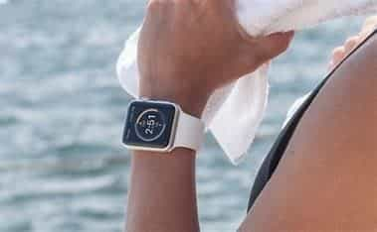
The Tech Behind the Device
Arduino Nano/Node Mcu: The brain of the device
Nrf module: making: for wireless signal transfer
Voice Recognition Module: Hands-free safety activation
GPS Module: Tracks real-time location
GSM Module: Sends location and emergency messages
Camera Module: Captures images or video during incidents
Microphone: Records audio for evidence
Shock Module: Delivers a self-defense electric shock
Pepper Spray Module: Deters attackers at close range

Slide 6
A Seamless Safety Experience
STEPS TO Step 1: Voice command activation Step 2: Automatic GPS tracking and GSM alert Step 3: Camera and voice recorder captures surroundings and audio Step 4: Shock and pepper spray modules are deployed for self-defense

Slide 7
WORKFLOW/ARCHITECTURE
PENDANT HOLDING CAMERA VOICE RECOGNITION AND RECORDER
SAY THE SAVED WORD
STARTS THE GPS GSM AND SEND THE LOCATION WITH SOS
STARTS THE RECORDING
ACTIVATES THE PEPPER SPRAY
STARTS THE TASER
SAY THE CLOSING WORD
WHOLE SYSTEM TURNS OFF

Slide 8
Key Features Breakdown
Voice Recognition: Quick and reliable safety activation with pre-set commands.
GPS & GSM Communication: Sends the wearer’s location to pre-set emergency contacts.
Camera & Audio Recording: Collects visual and audio evidence in real-time.
Self-defense Mechanisms: Shock module and pepper spray ensure last-resort protection.

Slide 9
Compact and Wearable
Lightweight design for everyday use
Sleek, modern look that can be worn discreetly
Built with durable materials for outdoor conditions

Slide 10
Real-World Applications
Personal safety while traveling
Protecting vulnerable populations (students, elderly)
Emergency response for outdoor adventurers
Security personnel in high-risk situations

Slide 11
Fast Response in Critical Situations
Device activation in under 2 seconds
Automatic emergency contact alerts
Self-defense deployment in real-time
No complex controls or interfaces – just voice

Slide 12
Overcoming Development Challenges
Integrating multiple sensors and modules into one device
Ensuring reliable voice recognition even in noisy environments
Power consumption management for long battery life
Compact design without compromising functionality

Slide 13

Looking Ahead
Adding more sensors like heart rate monitoring
Integrating AI for automatic danger detection
Increasing battery efficiency
Exploring partnerships for mass production and commercialization

Slide 14
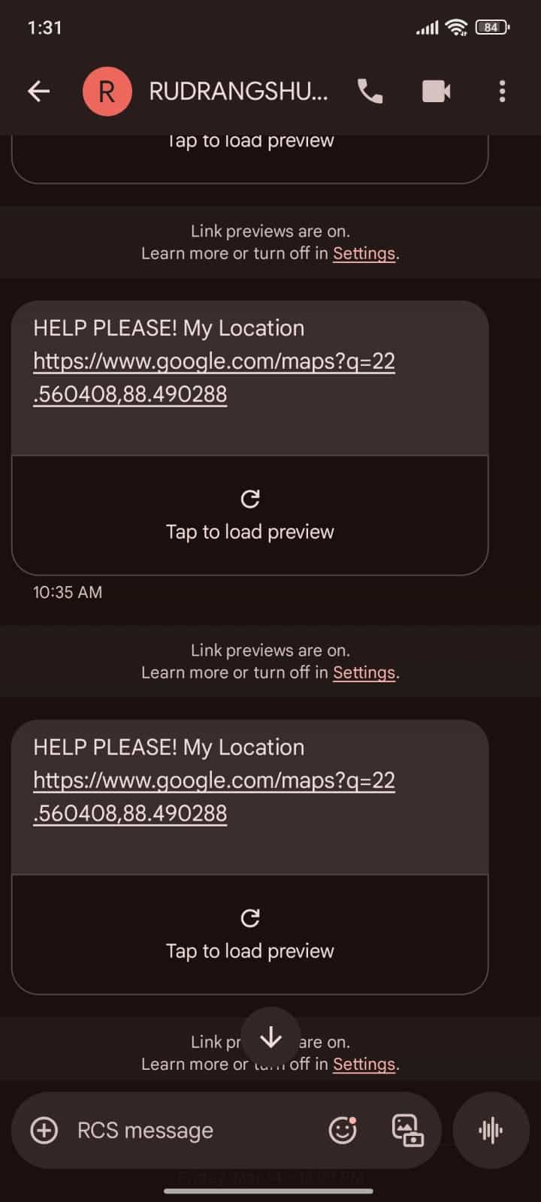
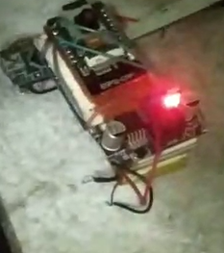
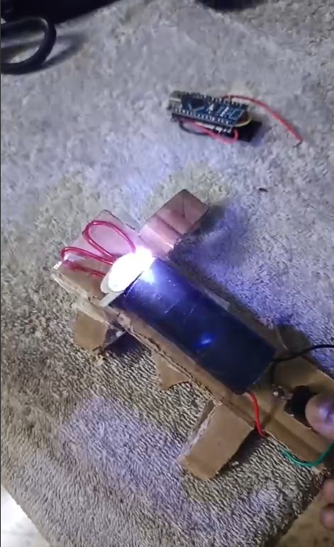
CURRENT PROGRESS
CAMERA AND VOICE
GPS+GSM SENDING LOCATION
TASER

Slide 15
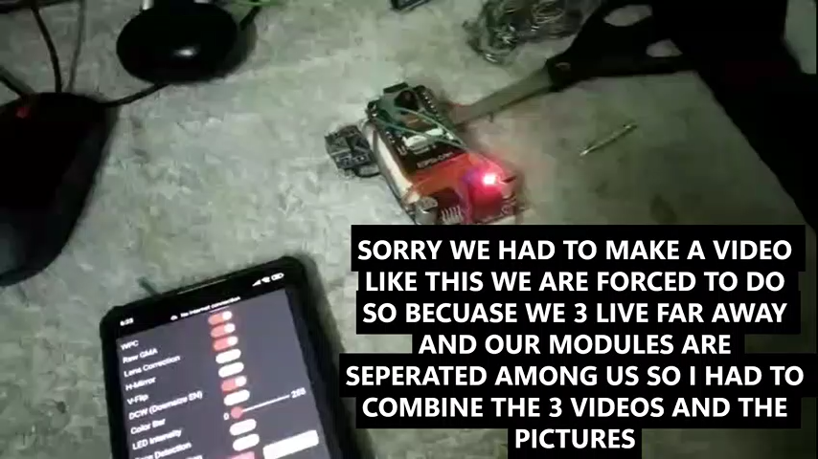
GITHUB: https://github.com/RUDRANGSHU2004/KAVACH.git
VIDEO OF THE CURRENT SITUATION OF THE PROJECT:

Slide 16
Conclusion
Empower Safety, Anytime, Anywhere
Impact on personal safety
The future of safety technology
THANK YOU FOR VIEWING OUR PROJECT

